Slide 1


Students Industrial Work Experience Scheme (SIWES)
By Emmanuel DAN-JUMBO
DE.2017/1190

Slide 2
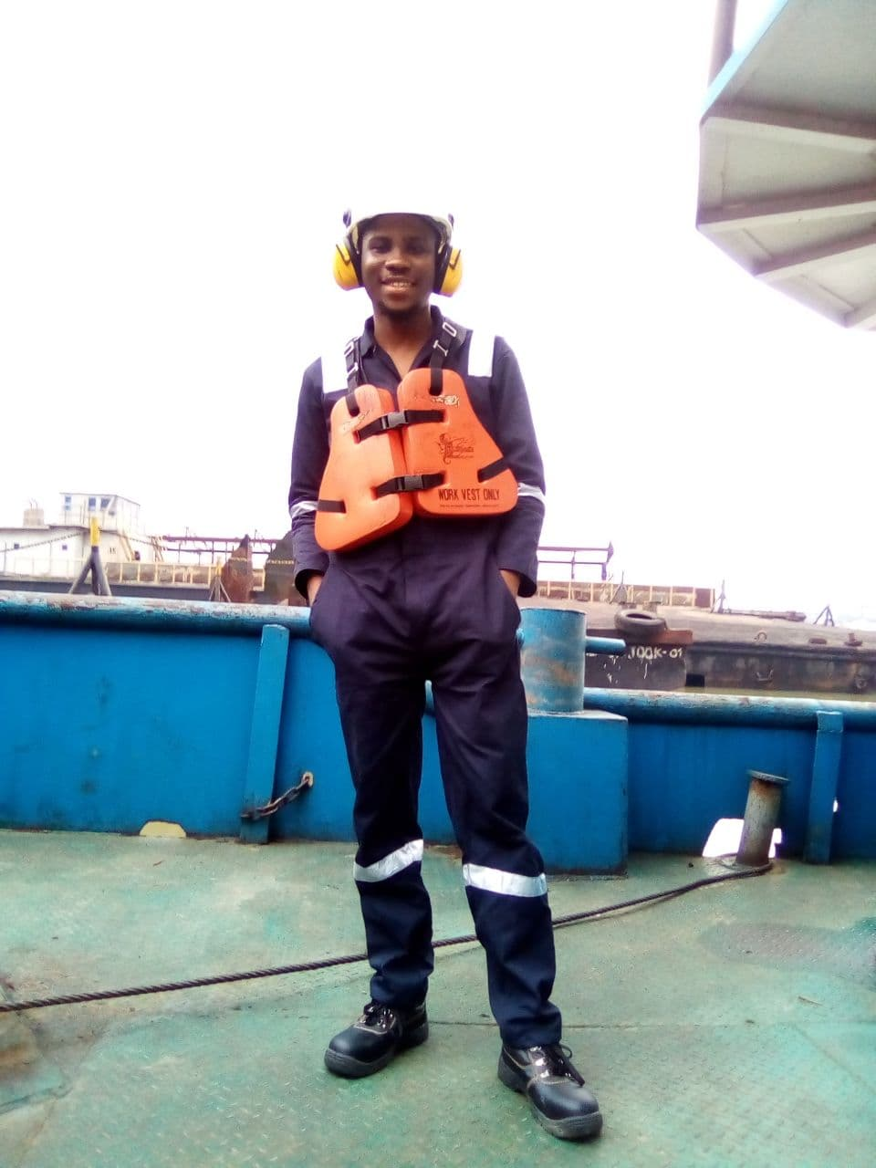
MY Industrial Experience
This slide explains my industrial experience in the engine department >>

Slide 3
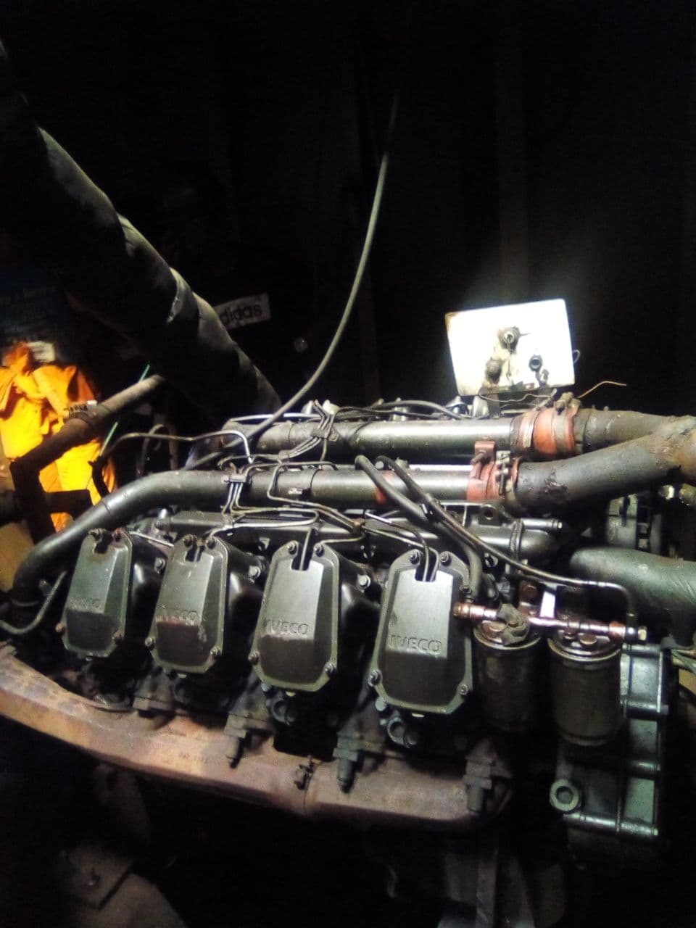
Running and maintenance of company based engines
We carried out routine check on the engine performance, by checking the pressure gauge, the dip stick, sound, exhaust, breath out and the vibration of the engine to ensure it is in a good working condition.
The following slides would explain these procedures in details

Slide 4
Engine starting procedure
We do a work around inspection on the engine, checking for leakage or loose bolt
We Check the fluids: the radiator, the oil gauge, the dip stick and the diesel tank
We make ensure that our battery terminal is well connected and we note the starting time.
The Following are the things, we watch out for during our daily watch keeping:

Slide 5
Sound
The sound of the engine should be steady, any increase or decrease show load increment or decrement.

Slide 6
Vibration
Vibration is affected by transient load and the type of mountain use, engine without resilient mountains vibrate more.
The mountain on which the engine is placed on could really affect the vibration.
So a stable mountain should be used.

Slide 7
Oil gauge and dip stick
The oil gauge in the power house is normal at 50 psi. We inspected the dip stick before starting the engine and when we notice abnormality we check the gauge.

Slide 8
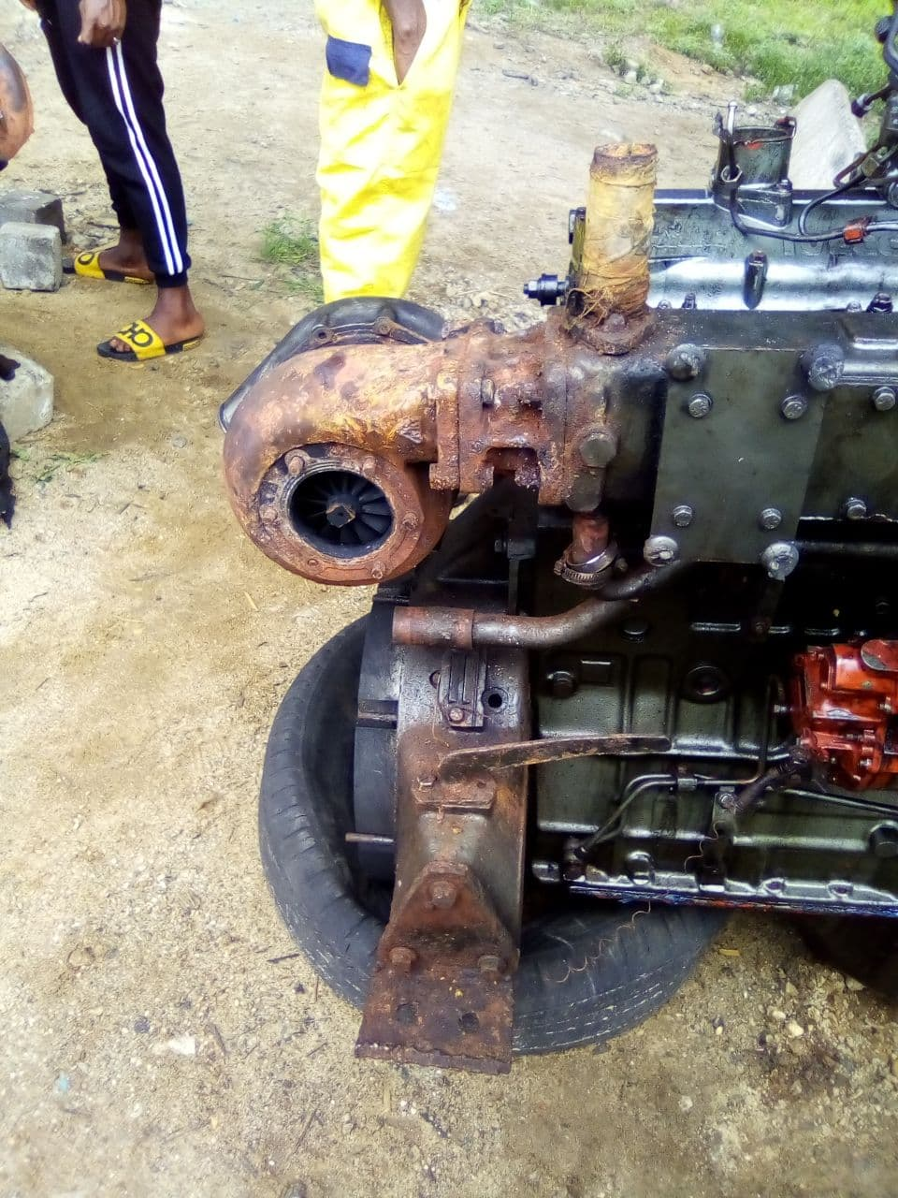
The turbo Charger
We also replaced the turbo charger as the blades on the old one (The one in the photo on the left ) some were broken

Slide 9
The Breath Out
The normal smoke from the breath out is fairly white, worm and not too obvious smoke any deviation from that will indicate that something is wrong in fluid system of the engine.
The following are what we check up monthly
The running hour
The air filter for dirt
The radiator coolant
The diesel tank to remove splurges and sediment

Slide 10
Precautions
We maintain clean and oil free environment
We emphasis ear muffler in power house and complete personal protective equipment

Slide 11
Work Challenges
The alternator of all the engines except the one in power house is not working and the batteries is not always charging, we have to carry the heavy batteries from power house to their respective locations.
Frequent removal and plugging of the batteries terminal head gradually destroy the batteries.

Slide 12
Conclusion
My experience at henry spencer Nigeria limited was a memorable one. I GAINED A LOT OF KNOWLEDGE IN REGARDS TO MARINE ENGINEERING OPERATIONS.

Slide 13
Thank you!

